Slide 1

Group project
Domain: automation
TOPIC: Humidity sensor-controlled bathroom exhaust fan

Slide 2

Motivation
PROBLEM:-
We have often seen that the accumulation of moisture occurs in a closed-up space like a bathroom. This can lead to the appearance of mould, which can cause several health issues.
SOLUTION:-
Thus, our project is designed to sense the humidity level in a bathroom and ventilate it until the wet floor dries up to minimize the build-up of humidity in the enclosed space.

Slide 3
Casing Fan
Arduino Uno R3
Temp and humidity sensor
Jumper wires
LCD Display
Materials
Required

Slide 4
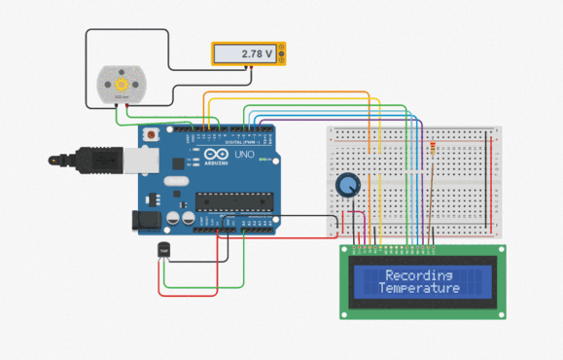
Tinkercad schematic
We have used a temperature sensor in our Tinkercad model as the humidity sensor is not available in tinkercad. The gif on the right side represents our Tinkercad schematic in which the motor starts running below a certain temperature. However, In our project, the condition for the motor to function is based on humidity in the reason.

Slide 5
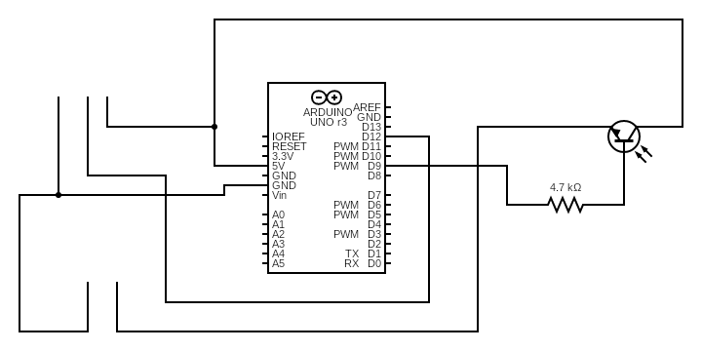
Humidity sensor
Transistor (npn)
GND
DATA
VCC
2 kΩ
FAN
-
+
Schematic diagram By Anish Roy

Slide 6
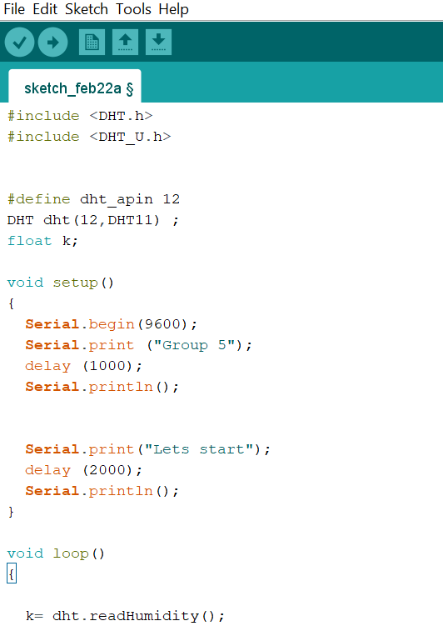
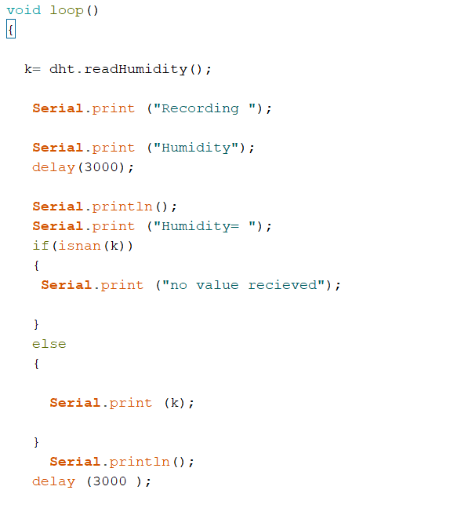
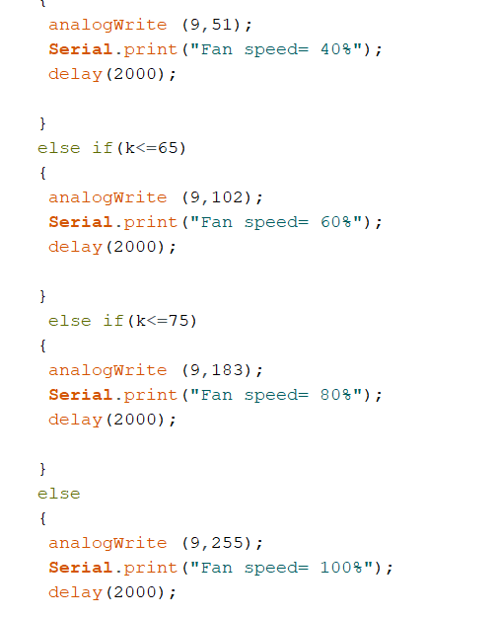
Code snippets

Slide 7
Work Plan
Project decision
Circuit design and schematic model
Hardware setup
Code formulation
Week 1
Week 2
Week 3
Final project
Week 4

Slide 8
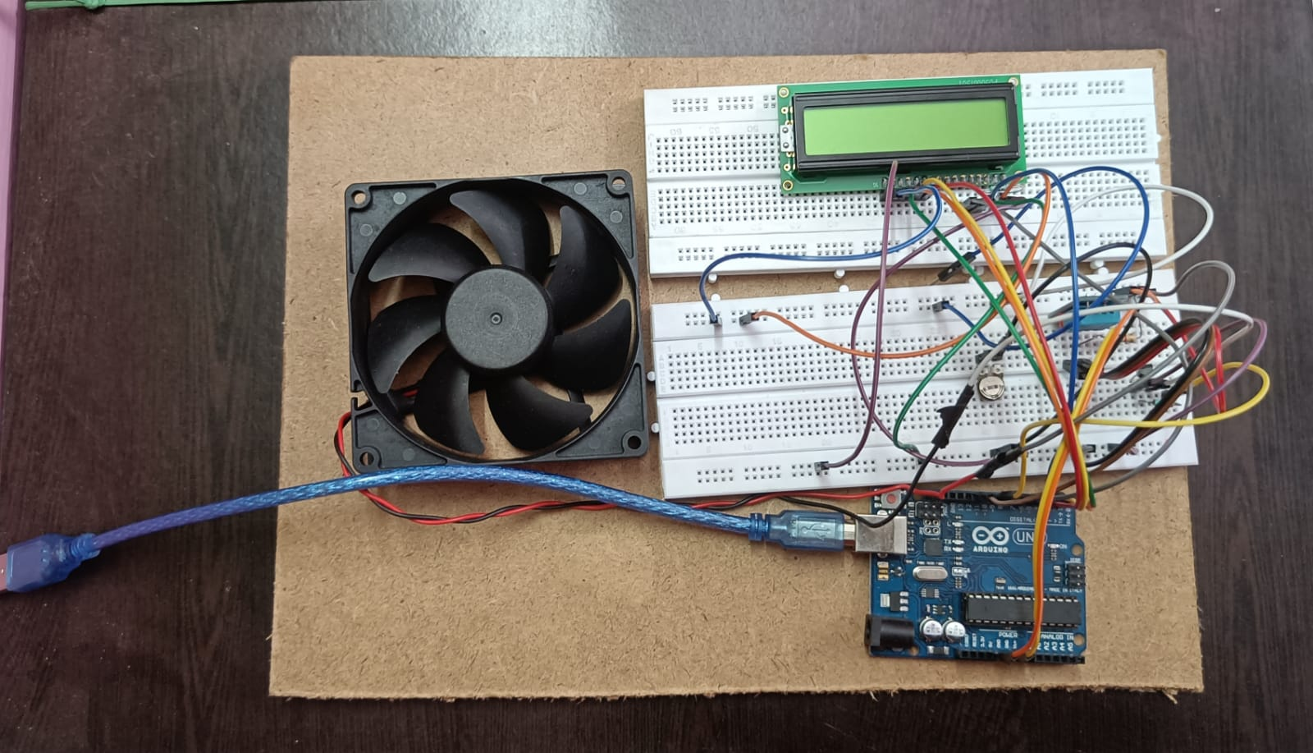
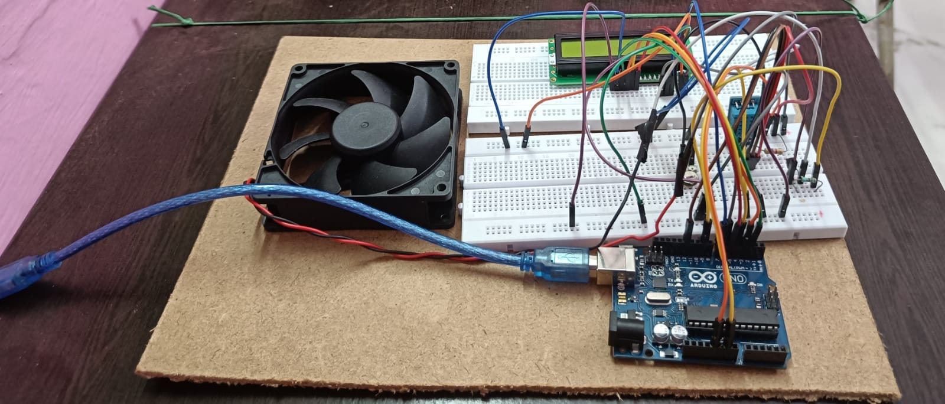
Physical Model

Slide 9
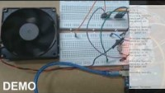
Demonstration video

Slide 10
Resources used
Websites and softwares :
Arduino IDE
Tinkercad (https://www.tinkercad.com/)
Smart draw (https://www.smartdraw.com/)
Circuito (https://www.circuito.io/)
Report of our project
Link:
https://docs.google.com/document/d/1FykkqtbJIc-cG-BRZ93rb5y9y5EIbmz5/edit?usp=sharing&ouid=102481915173551688607&rtpof=true&sd=true
Demonstration of physical model
Link: https://youtu.be/3Xu66k-JScE

Slide 11


Update
Amplification of the power was required to deliver and ensure the proper required power supply to the motor of our casing fan so we decided to use the transistor in our circuit so that the speed of the fan meets our expectation and provide good result.
Problem faced
During the operation of our project, the casing fan was not up to the mark of our expectation and we wanted it to run even faster and smoother.
Changes in the humidity reading takes time to reflect due to lower sensitivity of our sensor.
Our solution

Slide 12
Final outcomes
We could not add a lcd display for the output information due to faulty product, rather we used the serial monitor to dump the data.
What was achieved
We successfully created a working prototype of the project that could sense the humidity level and change fan speed as and when required.
Although our model is not that efficient it still gives decent performance.
What was left out

Slide 13




Team members and their roles
Divyanshu singh
Soumili mukherjee
Kanika guleria
Anish roy
21MI31012
21MT10054
21MT30011
21MI10009
“The guy who knows how to get things done”
Role – Research about functioning of DHT11 humidity +temp sensor and aid in code formation and presentation.
“The only hard working person in the whole team”
Role – Hardware assembling and simulating as well as aid in code formation and final editing.
“The supportive girl who will do the assignments ”
Role – Preparation of progression report and aid in hardware setup and final editing.
“The night owl who can code for infinity”
Role – Code Formation and testing of the code and presentation.

Slide 14


Slide 15

Thank you!

